Slide 1
Economic Globalization
Professor Wayne Hayes
10/24/2011
V. 0.4 | Build #5

Slide 2
The Summers Memo
Let’s look again at the memo from Lawrence Summers while the World Bank.
Make sure you get the economic logic of the memo and the connection to Lutzenberger, the producer of Banking on Disaster. Understand why and how this is an example of the disabling analysis.

Slide 3

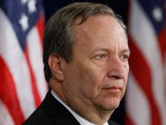
Summers and Ben Franklin?
Let me explain this . . .
Notes:
Franklin stove; public libraries; civic commitment; inventiveness; local democracy

Slide 4
How can the economy support sustainability?
What makes this question so ironic is that the growth in the physical scale of the economy under the prevailing regime of economic globalization has depleted resources, destroyed ecosystems, overwhelmed natural waste disposal sinks, waged war on subsistence cultures, and produced shocking maldistribution of wealth and income. How, then, can the economy be turned around to reinforce sustainable development rather than to destroy ecosystems, resource endowments, and indigenous cultures? This alchemy must be resolved to promote sustainability.
From my Economics and the Disabling Analysis.

Slide 5
At least two problems must be resolved:
With only 4.5% of the world's people, the USA consumes about 25% of global resources and produces the same proportion of greenhouse gases.
The USA dominates the Bretton Woods institutions --- the International Monetary Fund, the World Bank, and the World Trade Organization --- which shape the global economy, enforcing its ideology of neo-liberalism.

Slide 6
Situating the economy: ecology and economics
Definitions are based on the Greek root, Oikos.
Consider the distinction between means and ends.

Slide 7
Some disabling aspects of economics:
The growth imperative must be addressed. Remember the Limits to Growth issue.
Economics now trumps ecology, so invert and harmonize.
Remember Sachs’s conclusion: restraint, livelihood rights, restore. Eliminate abject poverty as a goal.

Slide 8
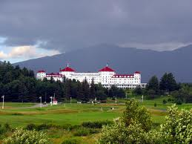
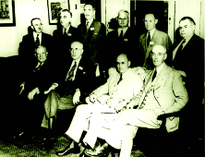
Bretton Woods, 1944
The North Atlantic economic system forms at Bretton Woods in July, 1944.

Slide 9
Economic globalization
My web site discusses:
The legacy and context of Bretton Woods near the end of World War II
The emergence of the Washington Consensus
The emergence of alternatives

Slide 10
Jeffrey Sachs of
Columbia University Earth Institute
Professor Sachs’s new book, The Price of Civilization: Reawakening American Virtue and Prosperity, sums up our critical moment this way (emphasis is mine):
"At the root of America's economic crisis lies a moral crisis: The decline of civic virtue among America's political and economic elite. A society of markets, laws, and elections is not enough if the rich and powerful fail to behave with respect, honesty and compassion toward the rest of society and toward the world. America has developed the world's most competitive market society but has squandered its civic virtue along the way. Without restoring an ethos of social responsibility, there can be no meaningful and sustained economic recovery.“
In ENST209, we call that civic virtue and responsibility the enabling analysis.

Slide 11
Conclusion to economics and globalization
“The real work of planet-saving will be small, humble, and humbling, and (insofar as it involves love) pleasing and rewarding. Its jobs will be too many to count, too many to report, too many to be publicly noticed or rewarded, too small to make anyone rich and famous.”
Wendell Berry
From Professor Wayne Hayes’s conclusion to economics and globalization.

Slide 12
Conclusion to economics and globalization
“Knowledge can be communicated, but wisdom cannot. A man can find it, he can live it, he can be filled and sustained by it, but he cannot utter or teach it.”
Hermann Hesse, Siddhartha
From Professor Wayne Hayes’s conclusion to economics and globalization.

Slide 13
Postscript: Occupy Wall Street
The OWS protest may be seen as an example of a Double Movement. See in particular the call for the Robin Hood Tax on financial transactions, a.k.a. the Tobin Tax.

